Slide 1
5 – Freedom of Speech
UECS3313
Computer Ethics and Professional Responsibility
Oct 2015
UECS3313-SE-Oct2015

Slide 2
Topics covered
Ethical and legal aspects of Free Speech
Posting sensitive material
Censorship and Political Freedom
Freedom of speech in Malaysia
UECS3313-SE-Oct2015

Slide 3
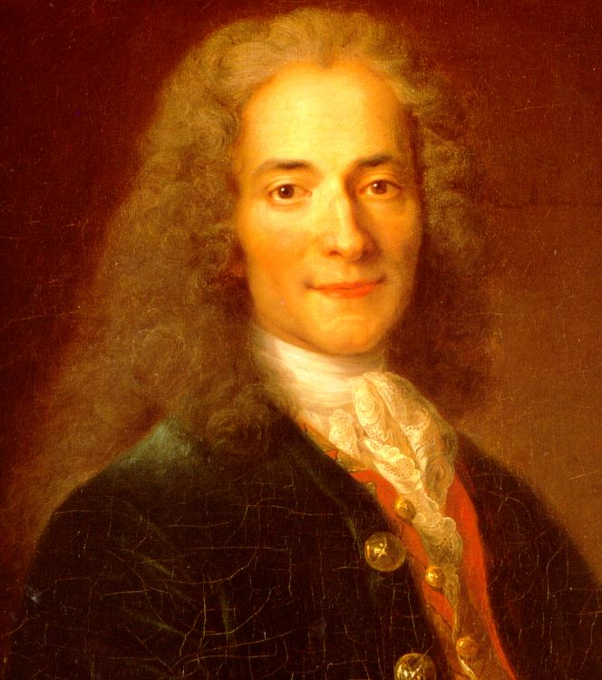
Freedom of speech
I disapprove of what you say, but I will defend to the death your right to say it !
Voltaire
UECS3313-SE-Oct2015

Slide 4
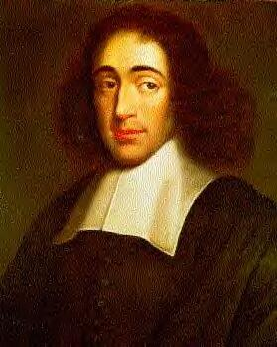
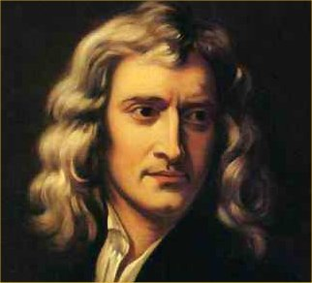
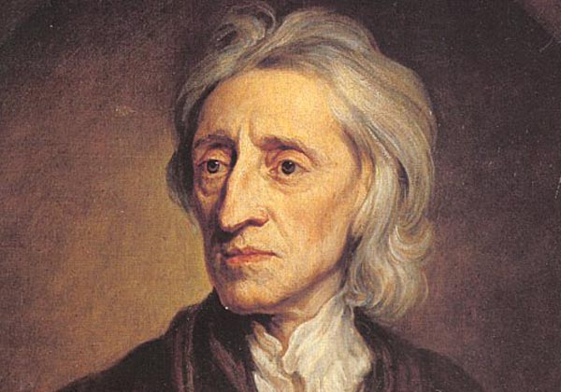
Age of Enlightenment
UECS3313-SE-Oct2015
Notes:
a cultural movement of intellectuals beginning in late 17th-century Western Europe emphasizing reason and individualism rather than tradition

Slide 5
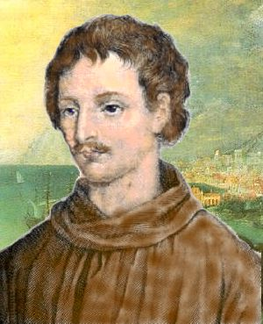
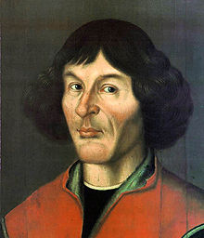
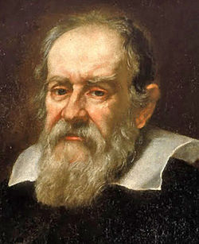
Church and science in Europe
Copernican controversy
http://burro.astr.cwru.edu/stu/pre20th_europe_church.html
UECS3313-SE-Oct2015

Slide 6
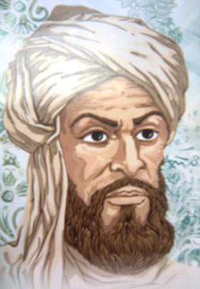
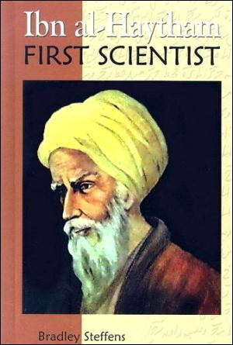
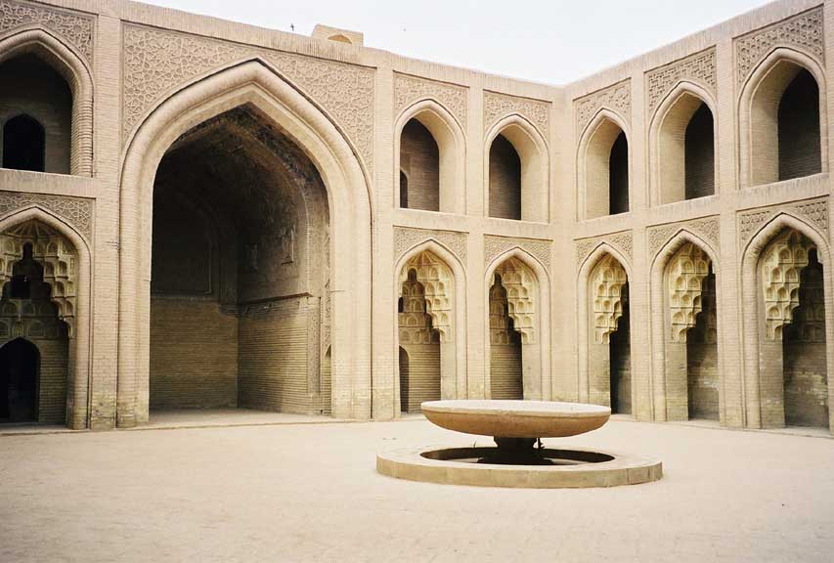
Islamic golden age
Ijtihad vs Taqlid
UECS3313-SE-Oct2015
Notes:
Ijtihad : an Islamic legal term that means "independent reasoning" or "the utmost effort an individual can put forth in an activity.
Taqlid : an Arabic term in Islamic legal terminology. It literally means "to follow (someone)", "to imitate"

Slide 7
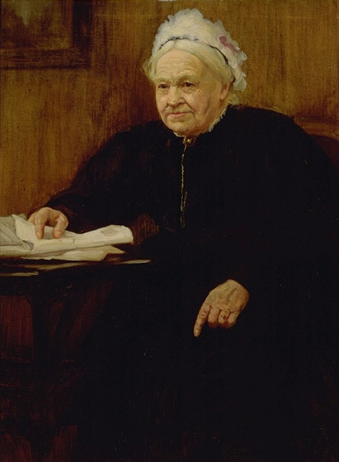
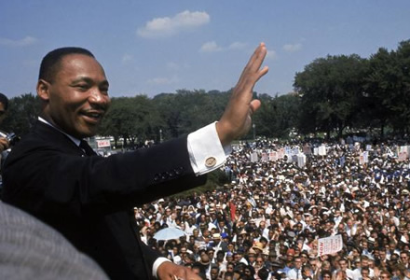
Civil rights movements
Equal rights for blacks
Equal rights for women
UECS3313-SE-Oct2015

Slide 8
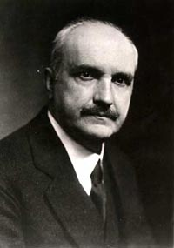
Why all these history lessons ?
Those who cannot remember the past are condemned to repeat it !
George Santayana
UECS3313-SE-Oct2015

Slide 9
Freedom of speech: Implications
Freedom of speech is meant to support rational, logical, creative thinking
  Speech should be constructive, even if critical
Freedom of speech is pointless if only used for emotional ventilation
  Ad-hominem attacks and destructive criticism
UECS3313-SE-Oct2015

Slide 10
Freedom of speech: benefits
Good decision-making at all levels is preceded by discussion and consideration of a representative range of view
Important to allow government to respond and correct mistakes
Important for ordinary citizens to obtain healthy social and political system
UECS3313-SE-Oct2015

Slide 11
U.S first amendment
Congress shall make no law respecting an establishment of religion, or prohibiting the free exercise thereof; or abridging the freedom of speech, or of the press; or the right of the people peaceably to assemble, and to petition the Government for a redress of grievances.
UECS3313-SE-Oct2015

Slide 12
Free speech principles
Was written precisely to protect offensive and/or controversial speech
Does not require the intended listener to listen.
A restriction on the power of government, not individual or private businesses.
UECS3313-SE-Oct2015

Slide 13
Classifications on offensive speech
Politically or religious sensitive views
pornography
racial and or/sexual slurs
libelous statements
controversial topics (abortion, homosexuality)
material that promotes hatred of certain groups of people
material that incites violence
information about how to build bombs
UECS3313-SE-Oct2015

Slide 14
Major US online censorship laws
Focus on protecting children
  Communications Decency Act (CDA)
  Child Online Protection Act (COPA)
  Children’s Internet Protection Act (CIPA)
Most overturned by Supreme Court
  Internet deserved the highest protection from government intrusion
UECS3313-SE-Oct2015

Slide 15
Guidelines for courts
Distinguish speech from action. Advocating illegal acts is (usually) legal
Laws must not chill expression of legal speech
Laws should not reduce capacity of adults
Solve speech problems by least restrictive means
UECS3313-SE-Oct2015

Slide 16
Video game violence
Violent video games have been controversial.
  A number of studies found a positive correlation between video game play and increased violent behavior in youth
  Others found no such link
Governments have attempted to enact legislation regulating distribution
  different video game content rating systems have been introduced in many countries.
UECS3313-SE-Oct2015

Slide 17
Censorship alternatives
Protect children, free speech (and sex !): software filters
  Block websites with specific words, phrases, or images, or rating systems
  Parents can choose categories to filter (e.g., sex or violence), and review a log of their child’s activity.
Online communities / social networks
  Expel subscribers and remove
  Aid law enforcement agencies
UECS3313-SE-Oct2015

Slide 18
Ethical issues for large companies
What kind of results to provide
  omit very offensive sites from search results ?
legal right of adults to purchase or read something
  Should business provide ?
Most major online companies have policies
UECS3313-SE-Oct2015

Slide 19
Ethical issues for smaller companies
in judging the usefulness of the information
anyone can access their site, and the mental and emotional state
consequences of misuse of this information
how to restrict
UECS3313-SE-Oct2015

Slide 20
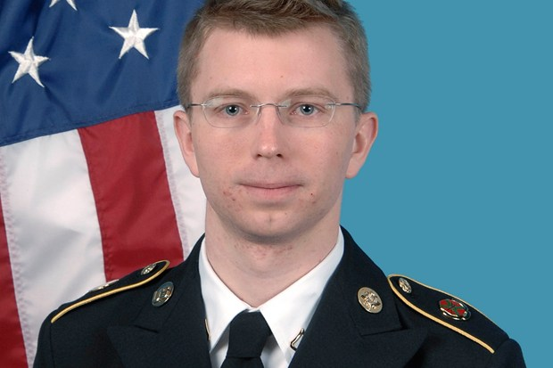
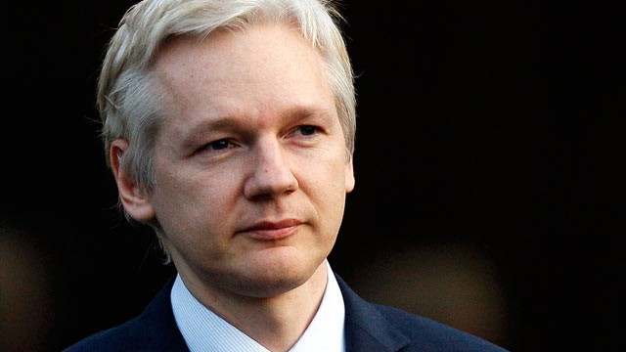
Whistleblowing and Wikileaks
Bradley Manning Julian Assange
UECS3313-SE-Oct2015

Slide 21
Wikileaks
Major leaks
  Afghan War Diary
  Diplomatic cables leak
  Iraq War Logs
  Guantanomo Bay Leaks
Controversial issues
  Endangering innocent lifes
  Endangering critical infrastructure
UECS3313-SE-Oct2015

Slide 22
Bradley (Chelsea) Manning
Key person involved in the leak
  Diplomatic cables, Iraq War logs and Afghan War logs
Court martialed and sentenced to 35 years
Controversial debate:
Whistleblower hero or traitor ?
UECS3313-SE-Oct2015

Slide 23
Ethical aspects of leaking
Against:
  Leaked documents are often obtained in illegal fashion
  can cause serious damage to many people or organizations indirectly
For:
  Evidence of serious wrongdoing
  corruption, political repression, safety lapses, coverups of violations of laws or or professional ethics
UECS3313-SE-Oct2015

Slide 24
Dangerous leaks
listing critical sites where damage or disruption would cause significant harm
put people at potential risk because it makes their presence and activity known to authorities of an opposing regime
UECS3313-SE-Oct2015

Slide 25
Ethical issues of leaking
infringe privacy and confidentiality
  Remove names (redaction)
of conflicting ethical requirements
  The public has a reasonable claim to a right to know
  criminal investigations and national security issues often require secrecy
Use laws requiring disclosure of certain public records and laws
UECS3313-SE-Oct2015

Slide 26
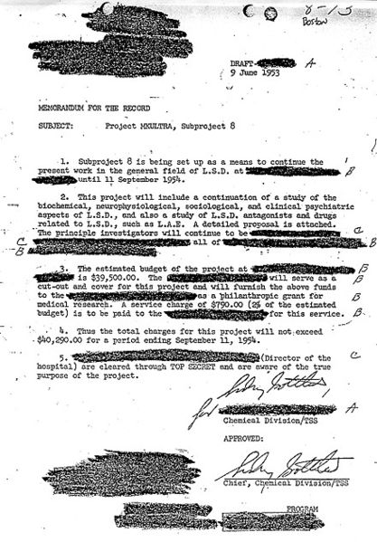
Redacted document
UECS3313-SE-Oct2015

Slide 27
Responsibilities of leak websites
Carefully previewing before releasing a huge mass of documents
Sufficient security to protect the whistleblowers.
  handle demands from law enforcement agencies for their identities
Verification of the authenticity and validity
  Serious harm from forged documents
UECS3313-SE-Oct2015

Slide 28
Censorship and Political Freedom
Internet is a threat in countries that lack political and cultural freedom
  Social media tool for organizing protests (Arab Spring)
Oppressive governments adopt countermeasures to block the flow of information
  Firewalls, filters, spyware, malware
UECS3313-SE-Oct2015

Slide 29
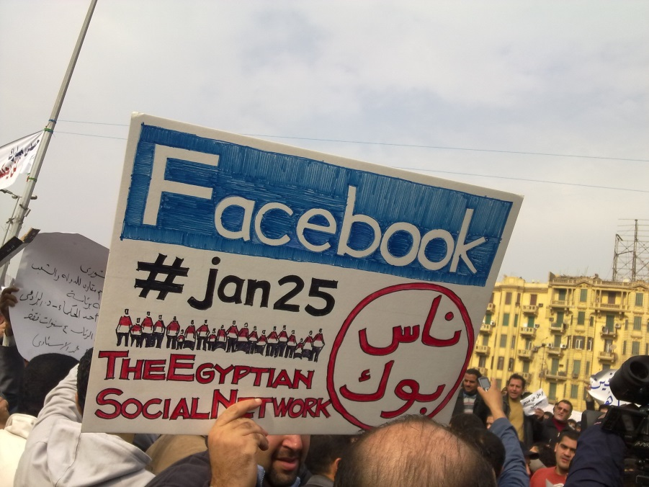
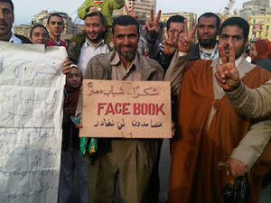

Social media and the Arab Spring
UECS3313-SE-Oct2015

Slide 30
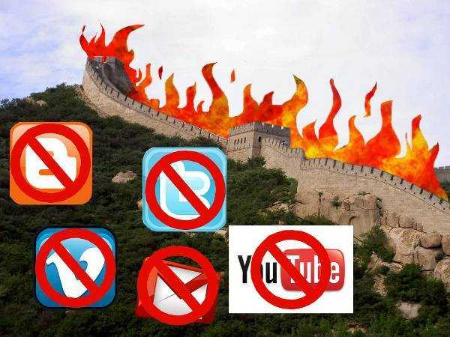
Great firewall of china
UECS3313-SE-Oct2015

Slide 31
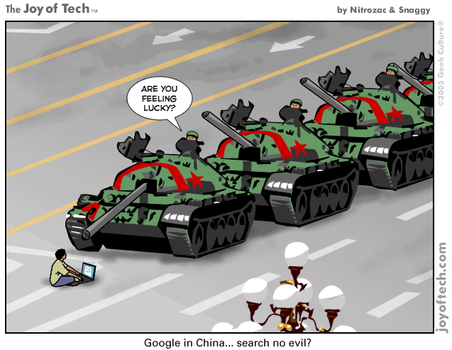

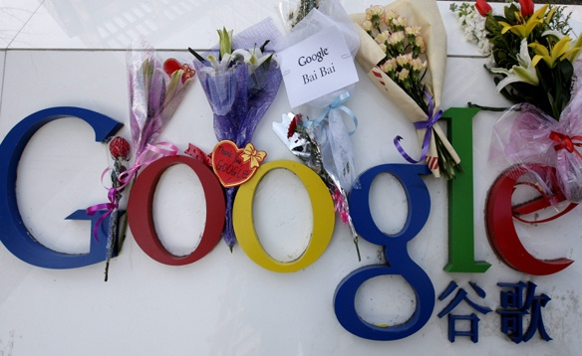
Google and China: the saga
UECS3313-SE-Oct2015

Slide 32
Working in foreign countries
Trade-off
  right to free speech and following the laws
Argument to follow:
  Limited access is better than no access:
  respect the culture and laws
  service provider is not ethically obligated
Against
  Endorsing govt’s viewpoint
  small number can have a huge impact
  Wrong to jail a person for views
UECS3313-SE-Oct2015

Slide 33
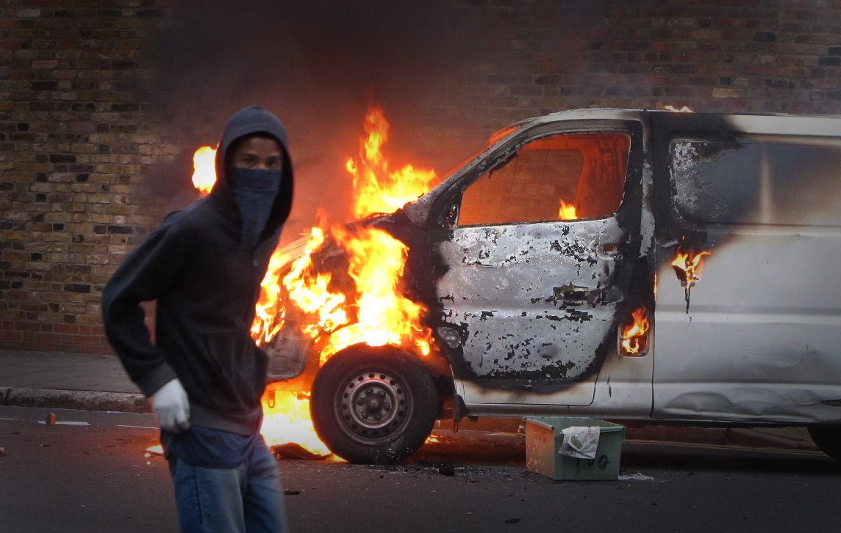
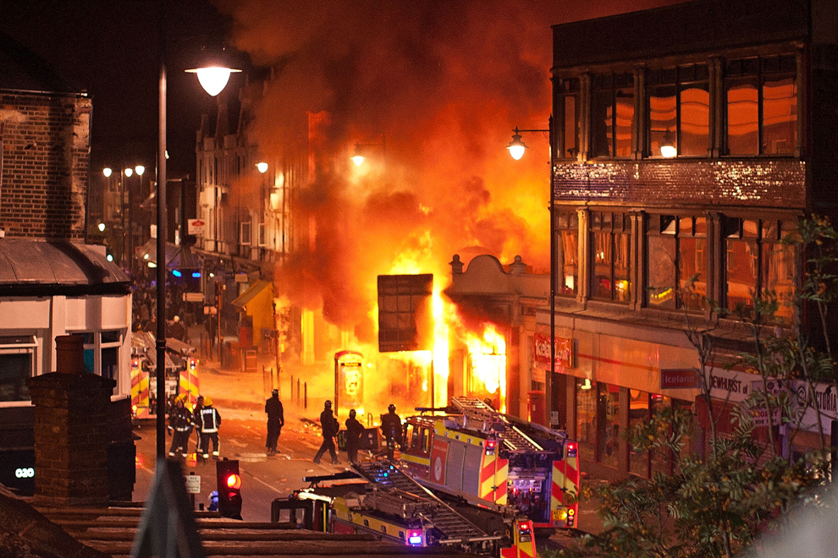
London riots
UECS3313-SE-Oct2015

Slide 34
Shutting down communications in free countries
Justification
  reasonable for limited situations when public safety is at risk
Arguments against:
  Police can abuse - preventing legitimate protests
  large-scale shutdown creates inconvenience
  Distinction: short term response vs long term repression
UECS3313-SE-Oct2015

Slide 35
Freedom House: Malaysian issues
arbitrary arrests against bloggers and Internet users
rise of disproportionate awards for defamation suits filed against bloggers
SOSMA allows interception without judicial order
increase in the use of “cybertroopers”
Digital divide: lack of access
UECS3313-SE-Oct2015
Notes:
SOSMA (Security Offenses (Special Measures) Act) 2012, replaces the ISA (Internal Security Act) 1960.

Slide 36
Article 10 Federal Constitution
guarantees Malaysian citizens right to:
  freedom of speech, freedom of assembly and freedom of association
Subject to qualifications
  friendly relations with other countries
  public order or morality
  contempt of court, defamation, or incitement to any offence
  Article 152, 153 181
UECS3313-SE-Oct2015

Slide 37
Sedition Act 1948
Prohibiting seditious speech
  Hatred or contempt against the government
  feelings of ill-will and hostility between different races
  Questioning anything relating to Article 152, 153 or 181
Exceptions
  Show mistakes, errors or defects for purposes of correction
UECS3313-SE-Oct2015

Slide 38
Official Secrets Act 1972
prohibits dissemination of material classified as an official secret
  Minister, Menteri Besar or public officer
  covers documents for cabinet and state executive councils, national security, defence and international relations.
Criticism
  Stifling dissent and reducing transparency
UECS3313-SE-Oct2015

Slide 39
Freedom of Information Act
Passed by Selangor and Penang in 2011
  allows access to all state documents
Points:
  does not apply to information controlled by the Federal Government, and does not override OSA restrictions.
  Requires applicants to state reason for request, and provides for arrest of individuals using it for anything contrary to that reason.
UECS3313-SE-Oct2015

Slide 40
Whistleblower Act 2010
give protection to the whistleblower
  confidentiality of their information
  immunity from civil and criminal action
  protection from detrimental action
Issues:
  Can revoke if investigation finds out whistleblower willfully lied
  Must report to enforcement agency
  Cannot question govt policy
  No protection from OSA 1972
UECS3313-SE-Oct2015

Slide 41
Section 114A Amendment to Evidence Act 1950
Offense to publish seditious, defamatory, or libelous content online.
  reverses the burden of proof
Concerns
  Chilling effect on freedom of expression
  intermediaries (such as online forum hosts) being punished unfairly
UECS3313-SE-Oct2015

Slide 42
Communications and Multimedia Act 1998
established to support the restructuring of the converged ICT industry.
  creates a new system of licenses and defines the roles and responsibilities
  Enforcement for offensive content on the Internet
Implemented by the MCMC
  oversees the Postal Services Act 1991 and the Digital Signature Act 1997.
UECS3313-SE-Oct2015

Slide 43
END OF LECTURE 5
UECS3313-SE-Oct2015

